Slide 1
Talkshow Scenario: Making “Erasmusville“ a better place

Slide 2
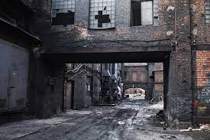
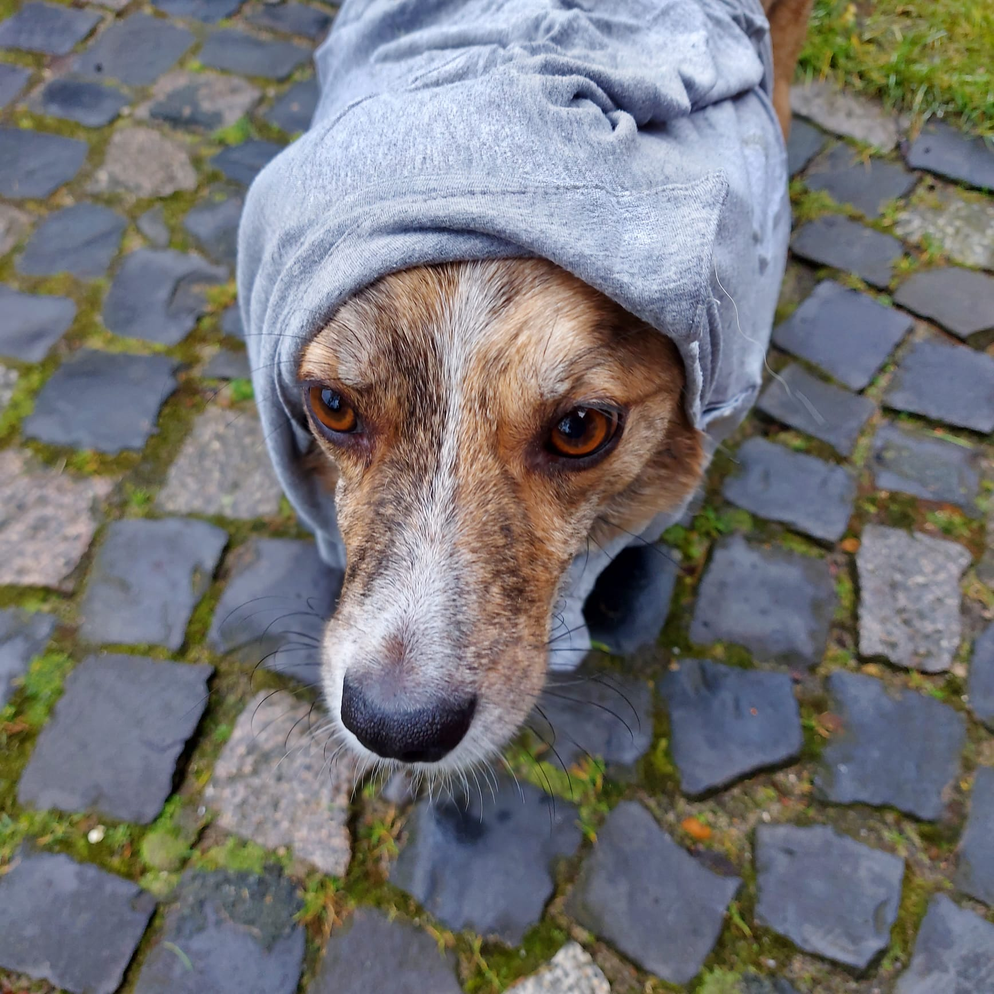
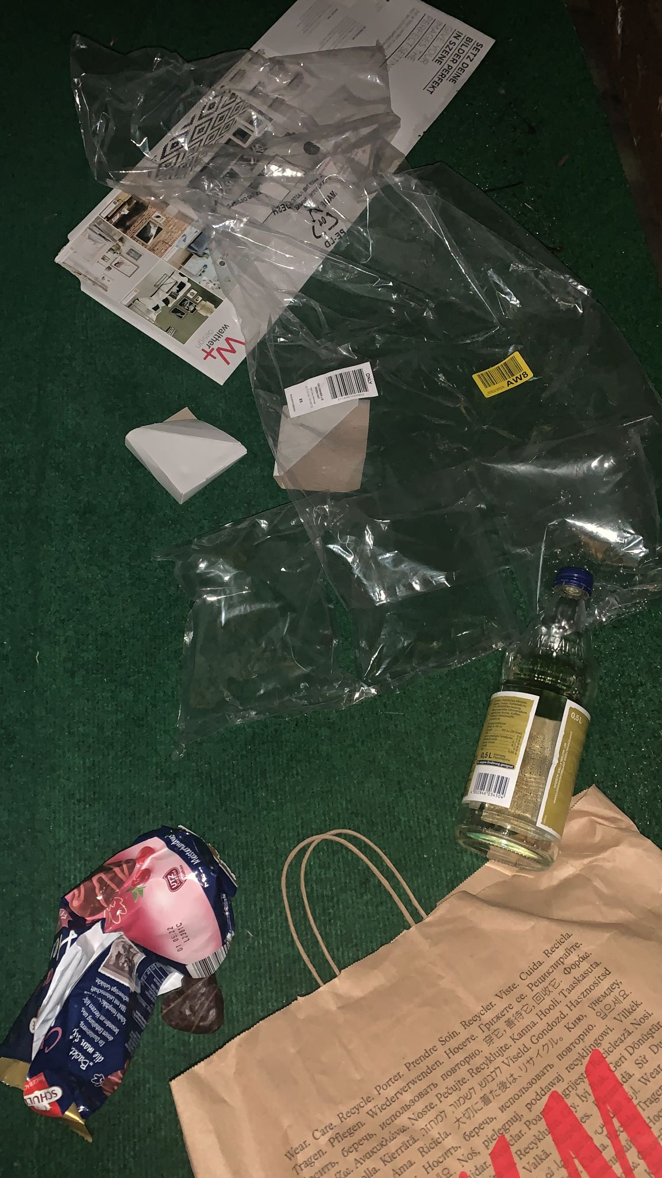
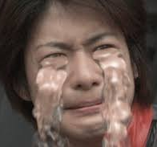
Imagine the following situation in ”Erasmusville“:
You live in a community named ”Erasmusville“ which is burdened with pollution, no greenery, smog and more.
The unemployment rate is very high and especially young people are moving away.
Your community is about to die and will be forgotten and maybe even deleted from the map one day.

Slide 3
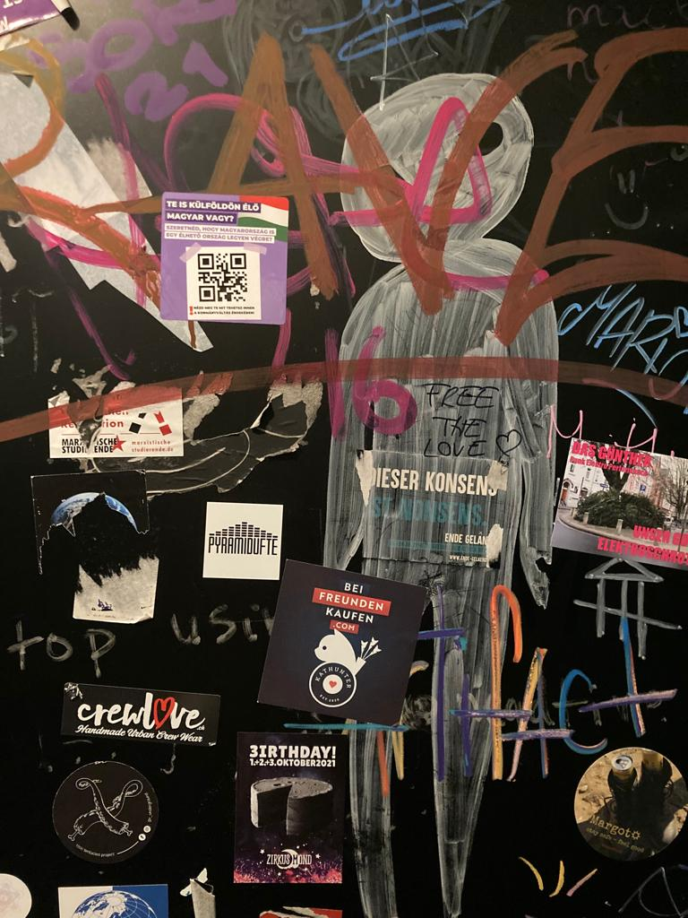
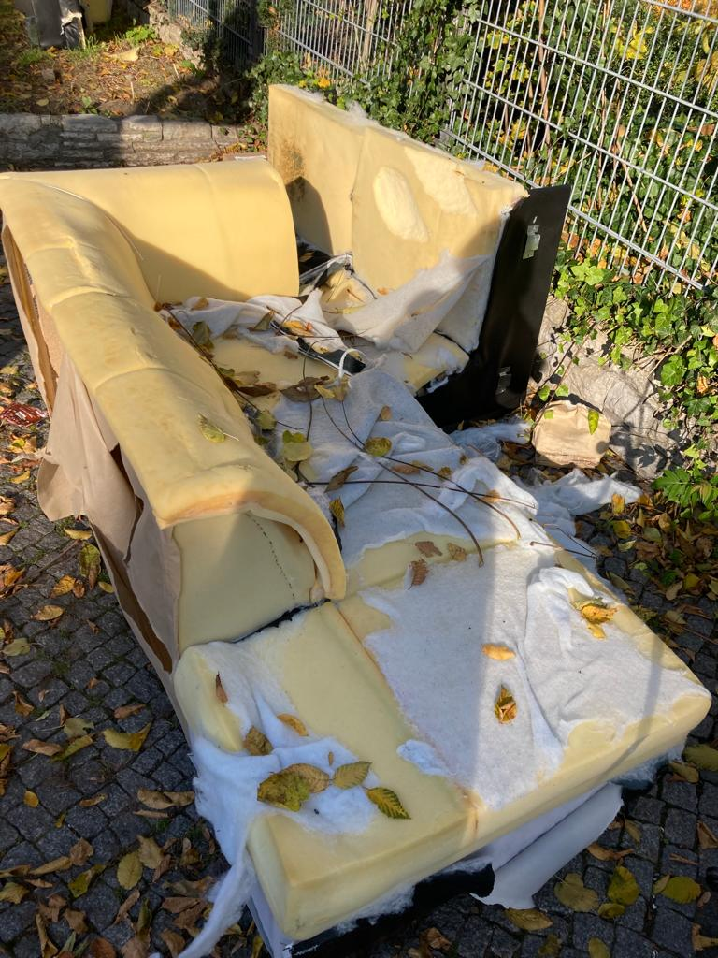
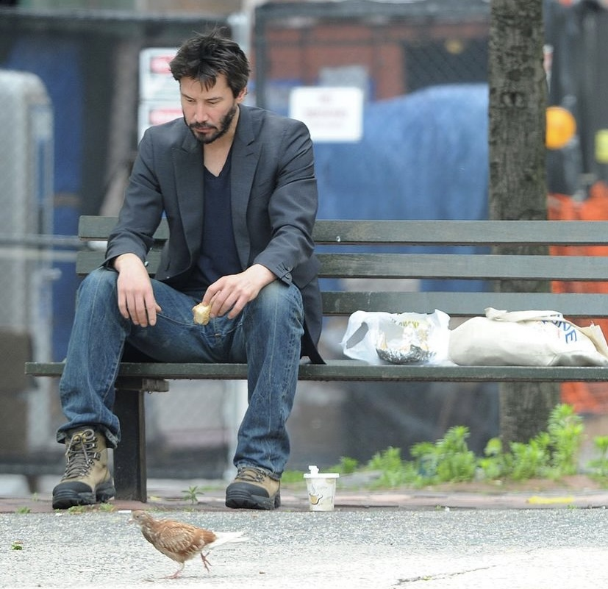
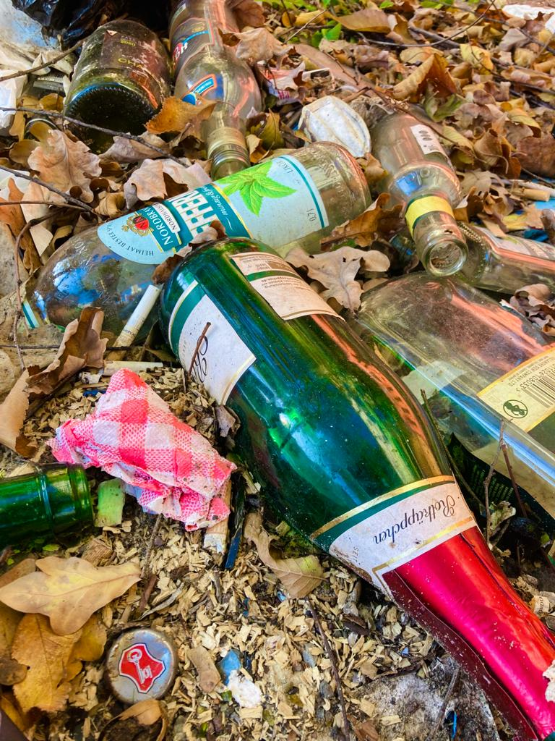
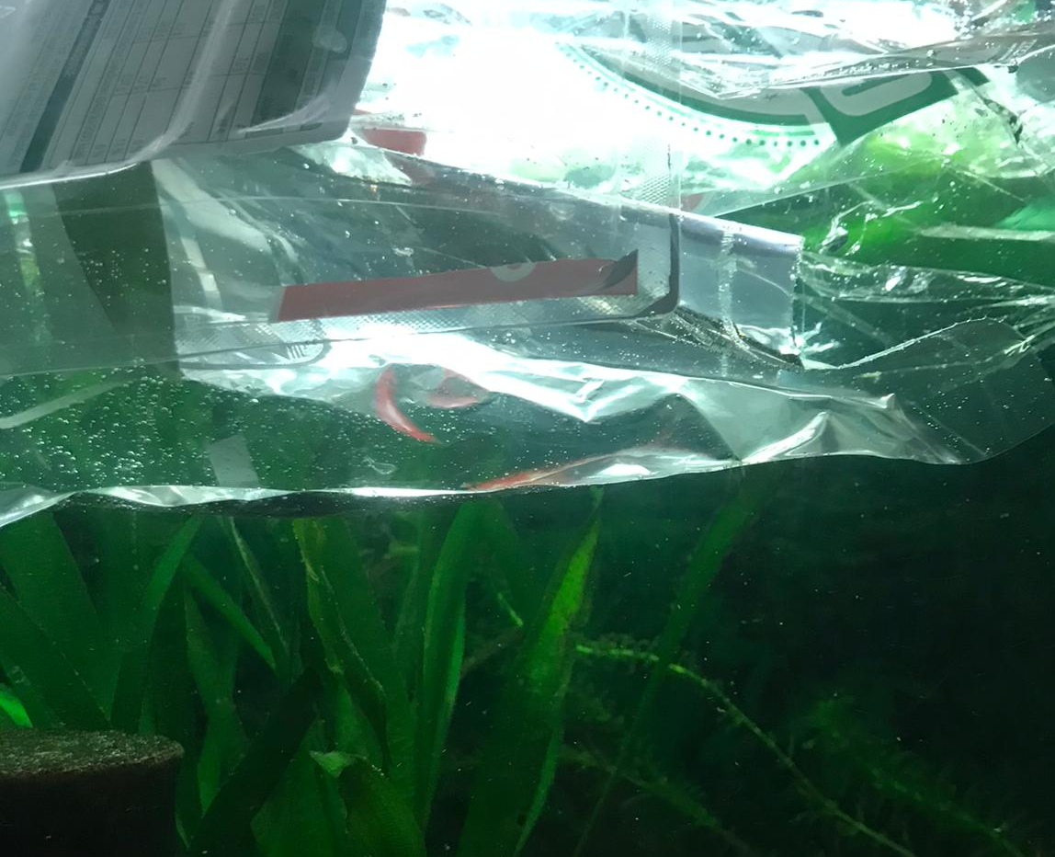

Slide 4
But: your community is strong!!! You want to save your city and make living there every human‘s dream.
To do that you get together with a group of people who are still there and who still have hope. You want to create a future and discuss the ideas according to your preferences and beliefs.
The following interest groups will take part in the discussion:
Farmers (Group 1)
Families with (young and juvenile) children (Group 2)
Industry and Trade associations (Group 3)
Food production companies (Group 4)
Transport companies (Group 5)
Local group for a more sustainable Living (Group 6)
Cultural Sector (Art, Music, Theaters, Entertainment) - (Group 7)
OF course, we need a host who helps With the Organization Of the discussion and who, in the end, will also represent the jury and summarize the different Viewpoints to then make a final decision for the plan of future “Erasmusville“ (Group 8).

Slide 5
You will be separated and assigned to one of the groups (1-8).
Group 1-7: Say what you want “Erasmusville“ to be like/what you want to establish/what your city needs to flourish etc. according to the needs of your group (Take notes).
Group 8:
try to find a way to structure your talk show and to lead through the discussion (Consider: you might have to deal with some tension).
Also think of measures that you feel are important to decide on what to include in the future vision of “Erasmusville“ and what not (e.g Finances).
! Time: 20 min (25 max).
! Each group appoints a “speaker” for the respective group!

Slide 6
Starting the show:
All cameras are switched off, apart from those of the speakers of each Group.
The host leads through the discussion.
Speakers try to convince each other of their interests but know that not everything can be put into practice.
Speakers can be supported by their group with the help of private messages.
If speaker feels lost/runs out of Arguments etc.: Speakers can change/Rotate (just let your group know)!
When host decides he has heard enough to decide what to put into practice in the end, he ends the Discussion.
Host aka Jury takes another 5 minutes to prepare their final speech (break-out Room) and presents what “erasmusville” will choose to do.

